Slide 1
LIFTIQ
Plan your workouts.
Track your progress.
A gym app for creating workout plans, recording exercises, and keeping track of each session.
MEMBERS: Omar Mohamed Samir(26100994)
Mohamed Abdulhaleem(26100413)
Ziad Mohamed(26103454)
Yassin Ehab(26103578)
Kevin Wael(26104126)
01

Slide 2
01 / TEAM & CUSTOMER
Customer discovery
We explored the challenges people face when organising their gym workouts.
TARGET CUSTOMER
THE PROBLEM
WHAT WOULD HAVE HELPED
Customer background.
Problem statement
What users need in one app
The customer complained that he:
•Took a lot of time Searching online for workout routines
• Writes the exercises in his phone Notes
• Uses the phone stopwatch to time rest breaks
The customer found it inconvenient to switch between different apps and tools to manage their workouts.
• Keep workout exercises together in one place
• Follow the workout without searching again
• Record sets, reps, and weights
• Time rest breaks inside the same app
Track progress
LiftIQ provides a solution by bringing workout organisation, set tracking, and rest timing together in one app.
02

Slide 3
02 / APP IDEAS & SELECTION
Three ideas considered
We compared three ideas and considered which one we could build well during the semester.
IDEA 01
IDEA 02
IDEA 03
LiftIQ
Study Planner
Expense Tracker
Create workout plans and record sets, reps, weights, and rest time.
Why it stood out: We saw an opportunity to create a practical gym app with useful features that we could realistically develop during the semester.
Organize assignments, deadlines, and study sessions.
Why we did not choose it: We wanted to focus on an app idea that was more practical for our team's interests and development goals.
Record purchases, organize spending, and set budgets.
Why we did not choose it: Already a common app idea with many existing alternatives, making it difficult to offer something unique.
OUR CHOICE: LiftIQ — we understand the problem, and its main features are achievable for this semester.
03

Slide 4
✦
WEIGHTED DECISION
Comparing LiftIQ, Study Planner and Expense Tracker
Criteria
Weight
LiftIQ
Study Planner
Expense Tracker
Customer Demand
30%
3/5
3/5
2/5
18.0
18.0
12.0
Practical Value
25%
4/5
4/5
3/5
20.0
20.0
15.0
Development Complexity
25%
3/5
4/5
4/5
15.0
20.0
20.0
Market Potential
20%
4/5
2/5
3/5
16.0
8.0
12.0
TOTAL SCORE
100%
69 / 100
66 / 100
59 / 100
LiftIQ
69%
Study Planner
66%
Expense Tracker
59%
Highest overall score
3 points below LiftIQ
10 points below LiftIQ
★
WINNER: LIFTIQ
LiftIQ scored 69/100, narrowly ahead of Study Planner (66/100), with stronger market potential.
Ratings are team estimates on a 1–5 scale. Weighted contribution = (rating ÷ 5) × criterion weight × 100.

Slide 5
03 / APP PROPOSAL
LiftIQ: what the app will do
For people who are new to the gym or want an easier way to organise their strength workouts.
STATEMENT
PROPOSAL
VALUE
Problem
Solution
Value
People often search online for workout routines, save exercises in their Notes, and use a separate timer for rest periods.
Users can follow their routine and record their workout without switching between Notes and the stopwatch.
LiftIQ brings workout plans, exercise tracking, and a rest timer together in one app.
CORE
OPTIONAL
MAIN FEATURES • FIRST VERSION
EXTRA FEATURES • LATER
• Create and name workout plans
• Add exercises to each plan
• Record sets, reps, and weights
• Mark each set as complete
• Use a rest timer
• Progress tracking
• Videos showing how to do exercises
• A record of past workouts
• Charts showing progress over time
Advanced progress charts and statistics.
HOW IT WORKS: Choose a workout → start → record sets, reps, and weights → take timed breaks → finish the workout.
05

Slide 6
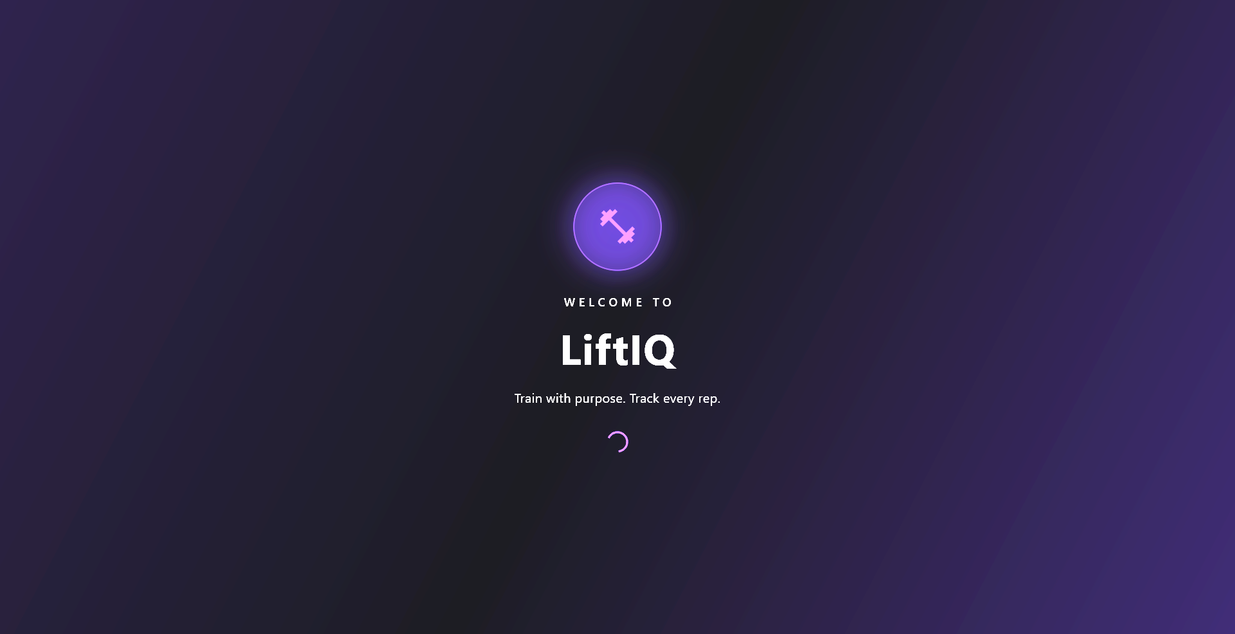
04 / SCREEN DESIGN & NAVIGATION • 01 WELCOME SCREEN
Welcome Screen
SCREEN 01 • WELCOME / ENTRY SCREEN
06

Slide 7
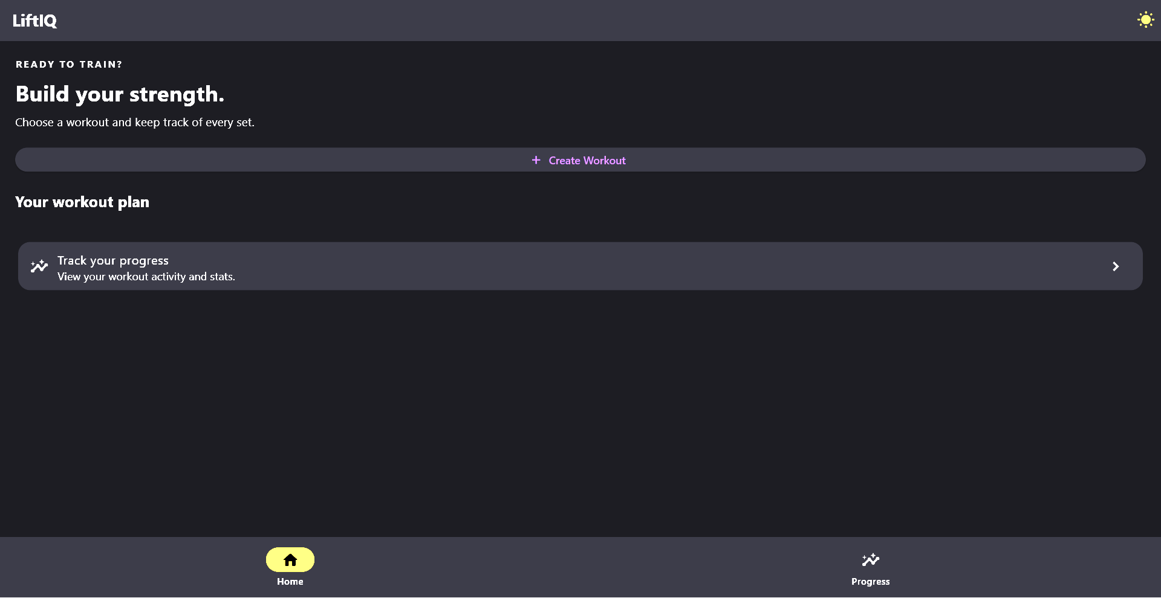
04 / SCREEN DESIGN & NAVIGATION • 02 HOME SCREEN
Home Screen
SCREEN 02 • WORKOUT HOME / PLAN SELECTION
07

Slide 8
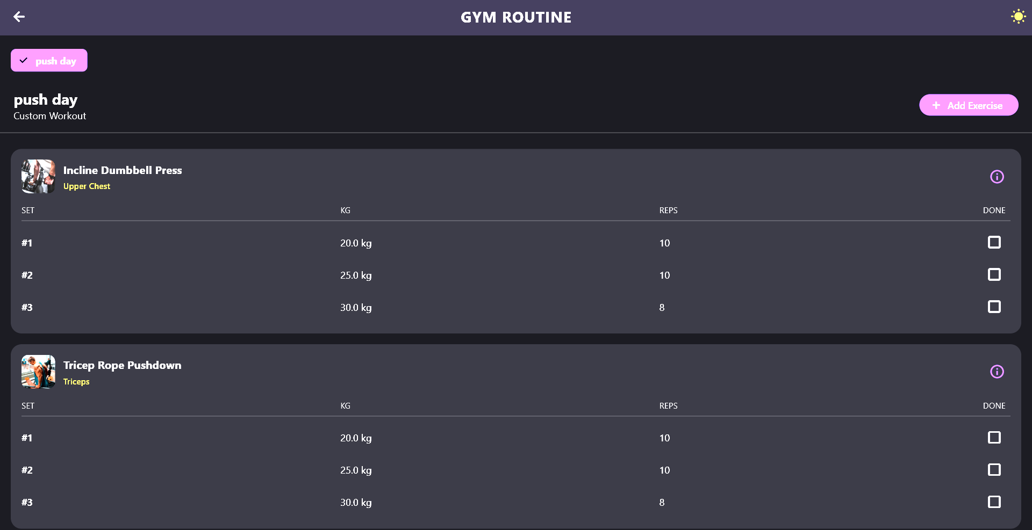
04 / SCREEN DESIGN & NAVIGATION • 03 ACTIVE WORKOUT
Active Workout
SCREEN 03 • ACTIVE WORKOUT / SET TRACKING
08

Slide 9
05 / SWOT ANALYSIS
LiftIQ: SWOT Analysis
A look at the app’s current strengths, limitations, and potential.
STRENGTHS
WEAKNESSES
• Workout plans, set tracking, and rest timer in one app
• Practical and focused on gym sessions
• Custom workout creation gives users flexibility
• Limited features in the first version
• Workout details require manual entry
• New app with no established user base
OPPORTUNITIES
THREATS
• Add workout history, progress charts, and exercise videos
• Gather feedback from gym users
• Expand exercise library and customization
• Established fitness apps offer similar features
• Users may prefer familiar or free alternatives
• Bugs or unreliable saved data could reduce trust

Slide 10
05 / NEXT STEPS
What we will do next
The next steps are to finish the main features and make sure the app works well.
Identify the needs of people who want to manage their workouts more easily.
Develop the first version around these needs , then gather feedback from users
Finish the screen designs
Make sure that the screens are clear and easy to move between.
Build the main features
Finish workout creation, set tracking, and the rest timer.
Try it and fix problems
Test the app, find problems, and improve it.
Save workout information
Keep workout plans and completed sessions so users can view them later.
GOAL: bring workout plans, set tracking, and rest timing together in one simple app.
10

Slide 11
THANK YOU.
Any questions?
LIFTIQ • PLAN YOUR WORKOUTS. TRACK YOUR PROGRESS.
11

